Slide 1
Food labelling

Slide 2
Summary
1. What is a food label?
2. Components of Food labels
3. Eco-label

Slide 3
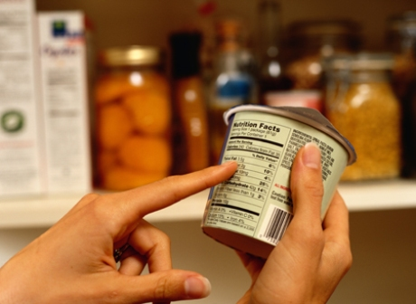
1. What is a food label?
Label is a any written, printed, lithographed, engraved or ilustrated material that contains product indentification and accompanies the product or adheres to its packaging.
It provides information from the food manufacturer to the consumer and helps tell consumers what they are buying.

Slide 4
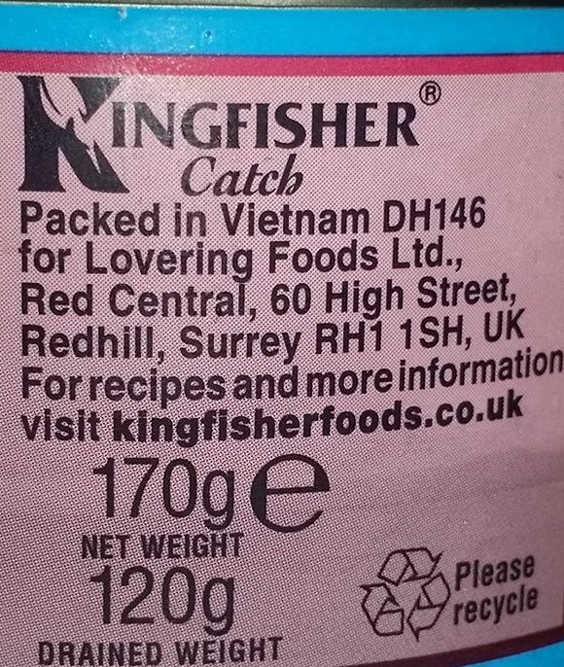
What should Food Labels tell you?
Food labels contain mandatory information and optional information.
Some information on Food Labels is:
Mandatory - the manufacturer/packer has to include it by law.
Voluntary – the manufacturer/packer may or may not include it.

Slide 5
2.Components of Food labels
Product Name
Net contents
Food labels
Name and Adress of the Manufacturer
Ingredients
Sell by/ expiration date
Nutritional claims
Nutrition facts

Slide 6
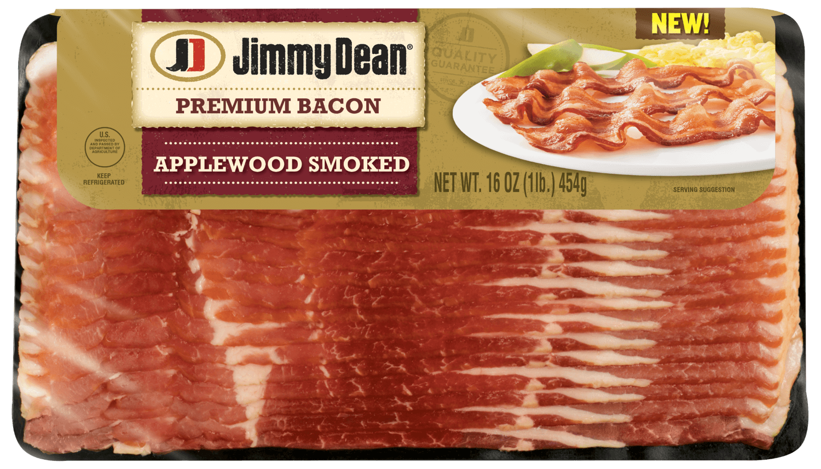
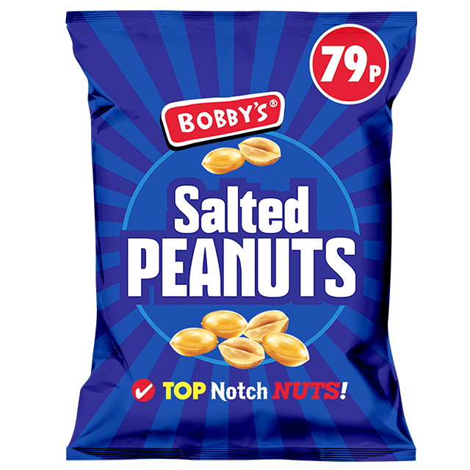
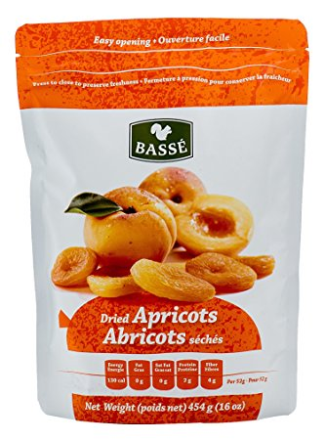
Product Name
It is important that the name of the food is clear and not ambiguous or misleading. If the food has been processed in some way, the process must be included in the title e.g. dried apricots, salted peanuts, smoked bacon.

Slide 7
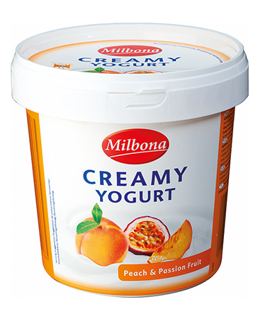
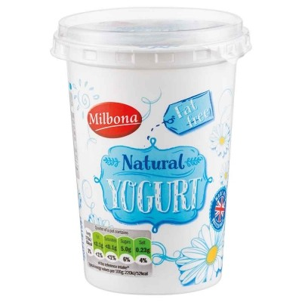
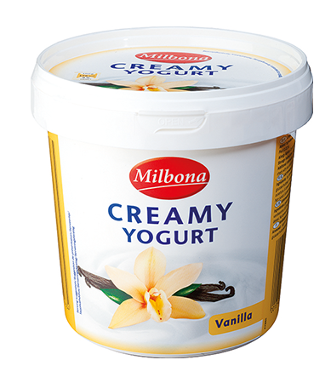
The name must also describe the differences between apparently similar products. For example, ‘fruit yogurt’ differentiates it from yogurt using artificial flavourings.

Slide 8
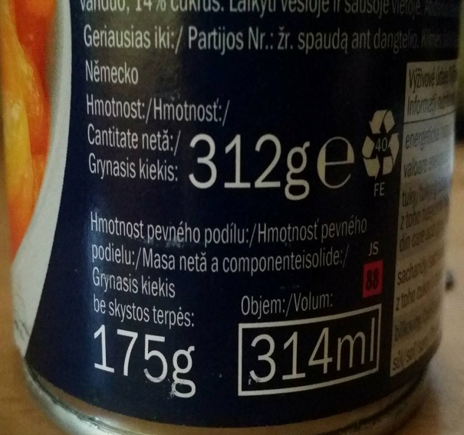
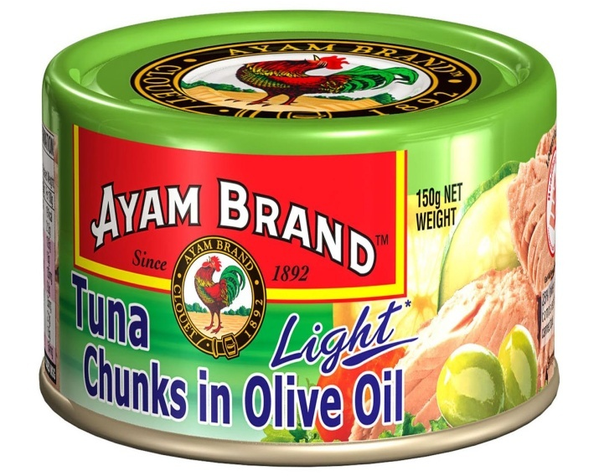

Net contents
The weight or volume of the food must appear on the label. By comparing weight to the price of different brands, consumers can make sure they get value for money. Some foods such as bread, tea and butter are only sold in standard quantities. The net content shows the weight, number or quantity of the package.

Slide 9
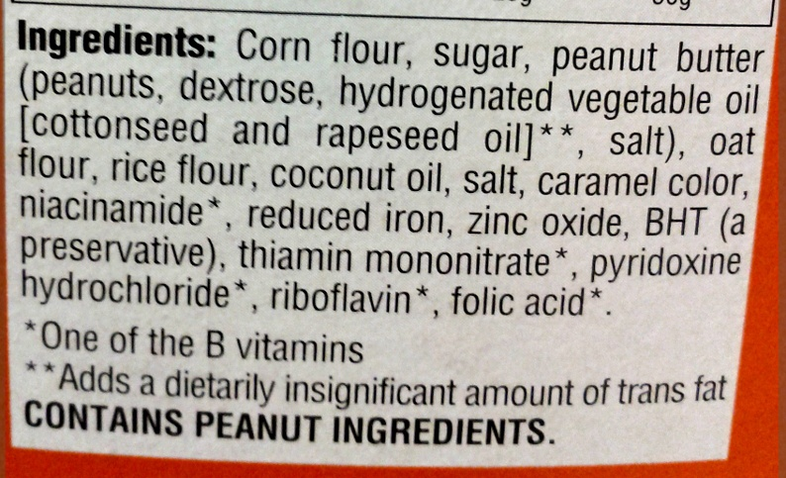
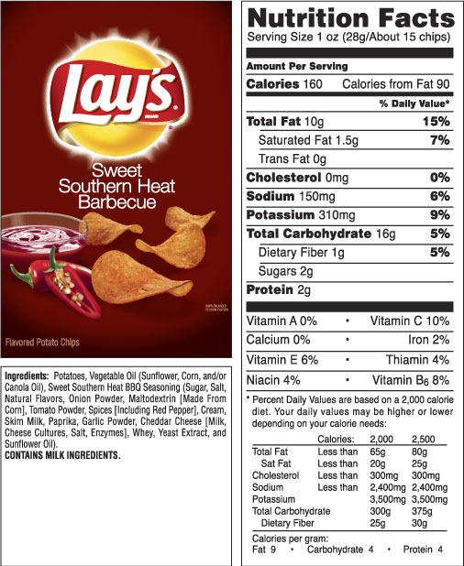
Ingredients
Ingredients are listed in order of weight, according to the amounts that were used to make the food, starting with the largest ingredient and ending with the smallest. Food additives and water must also be included in the list if they have been added.
some ingredients labels list common allergies found in their processing plants , even if they are not contained in the particular food product.

Slide 10
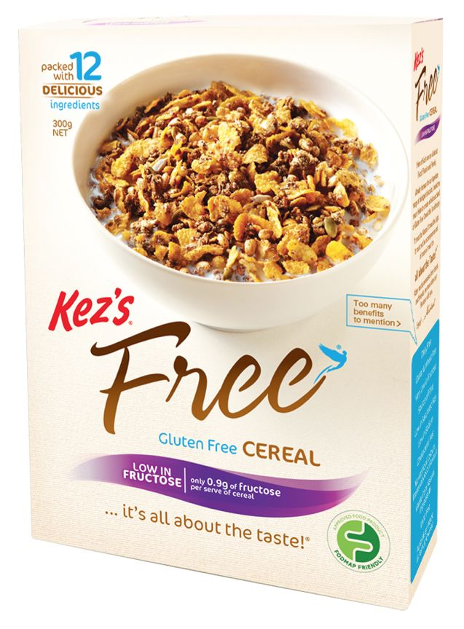
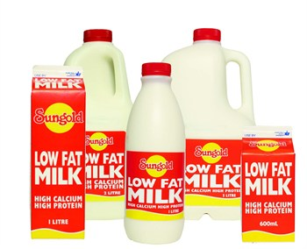
Nutritional claims
Refers to products with a low fat, calorie, sugar-free, gluten-free diet.

Slide 11
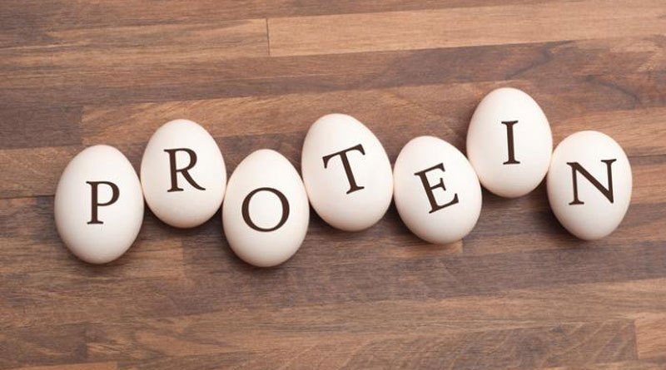
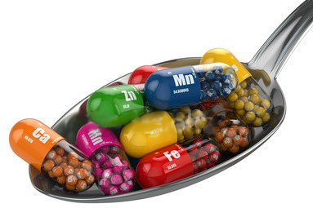
Nutrition facts
The current rules specify the nutrients that can be included. The information has to be presented per 100g/ml, but could also be provided per portion. There are macronutrients and micronutrients.
Macronutriens: people needs the eat these nutrients in large quantities. (protein, fat, carbohydrates);
Micronutrients: people needs the eat these nutrients in small quantities. (vitamins, mineral);

Slide 12
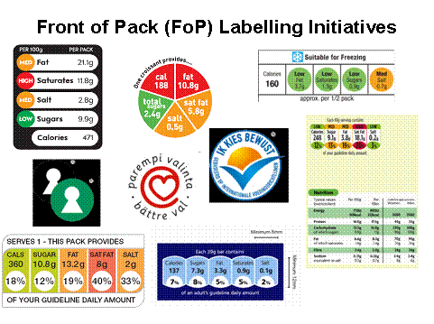
Most of the major supermarkets and many food manufacturers choose to display nutritional information on the front of pre-packaged food and drinks.
There are two major schemes for front-of-pack labelling in place: traffic light labelling and Guideline Daily Amount (GDA) labels. Some packs may use a combination of the two.

Slide 13
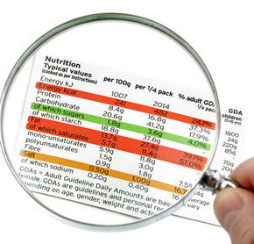
Traffic light labels on the front of pack provide information on high (red), medium (amber) or low (green) amounts of sugars, fat, saturated fat and salt present in the product, expressed per 100g/ml of the food/drink.
This front-of-pack labelling scheme was developed by the Food Standards Agency to give an at-a-glance indication of whether a food is a healthier choice.

Slide 14
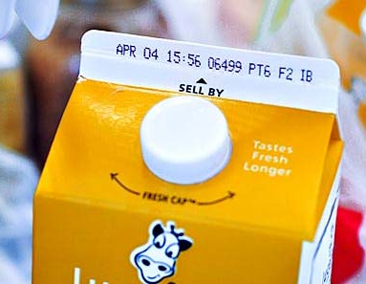
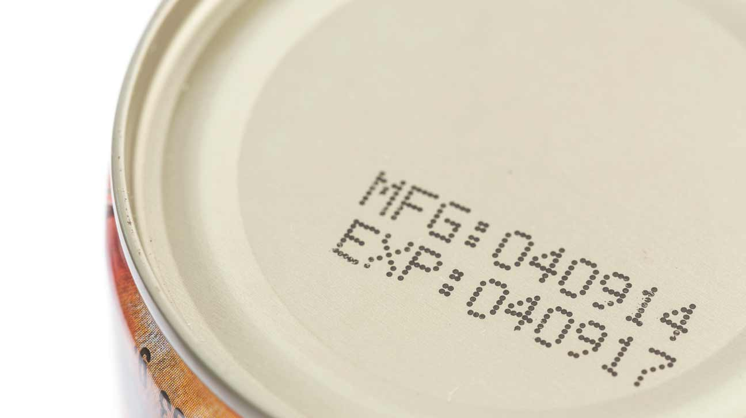
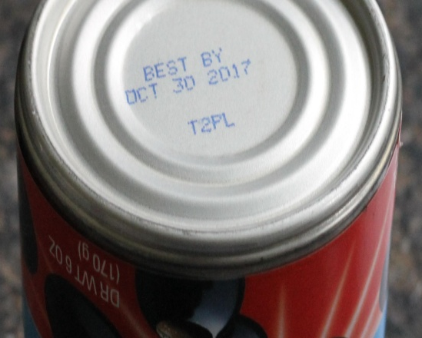
Sell by/expirtation date
Sell by date tells you the product should be sold by the store by this date. It can still to be consumed for up to a week after this date.
Expiration date tells you the last day the product should be consumed.
Best by date tells you the last date the product is at its freshest. It can still be eaten after this date.

Slide 15
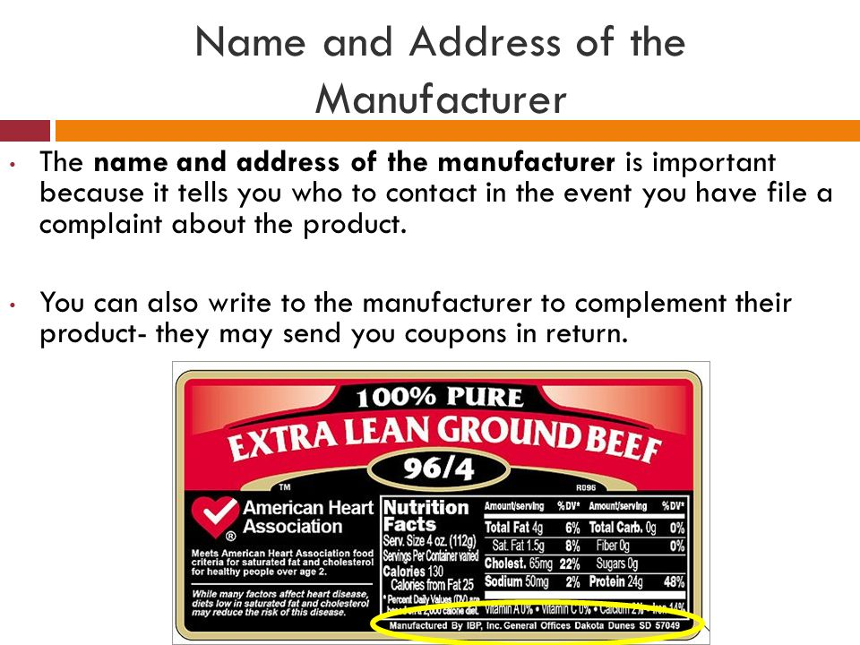
Name and Address of the Manufacturer
The name and address of the manufacturer is important because tells who to contact in the event you have file a complaint about the product. You can also write to the ,manufacturer to complement thier product-they may send you coupons in return.

Slide 16

3. Eco-label
EU Ecolabel or EU Flower is a voluntary ecolabel scheme established in 1992 by the European Commission.
The label includes a green flower with inclined green "ϵ" (Greek epsilon) as the flower, surrounded by 12 blue stars. On EU Ecolabelled products, it must always be used together with the license number. Because of the logo, the label has a nickname EU Flower.

